Slide 1
Shell Sort

Slide 2
Shell Sort
Explanation of Shell Sort
Visualization of Shell Sort
Implementation of Shell Sort

Slide 3
Shell Sort
The shell sort improves on the insertion sort by breaking the original list into a number of smaller sublists,
The unique way that these sublists are chosen is the key to the shell sort.

Slide 4
Shell Sort
Instead of breaking the list into sublists of contiguous items, the shell sort uses an increment ”i” to create a sublist by choosing all items that are ”i” items apart.

Slide 5
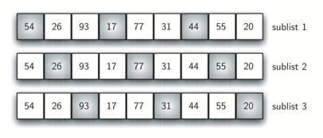
Shell Sort

Slide 6
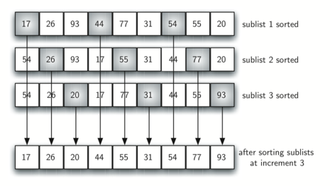
Shell Sort

Slide 7
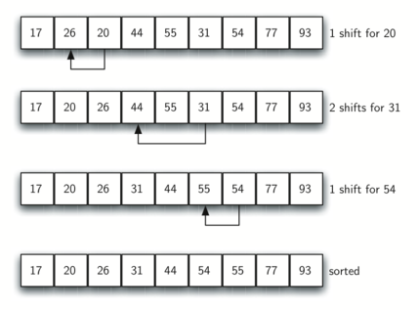
Shell Sort

Slide 8
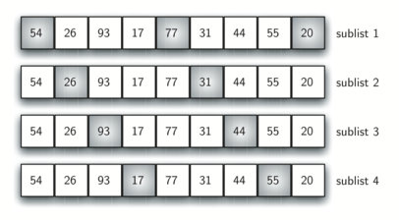
Shell Sort

Slide 9
Visualizations
Let’s take a look at some visualizations!

